Slide 1
Using XML technologies for various data format transformations
Maja Pušnik, Boštjan Šumak

Slide 2
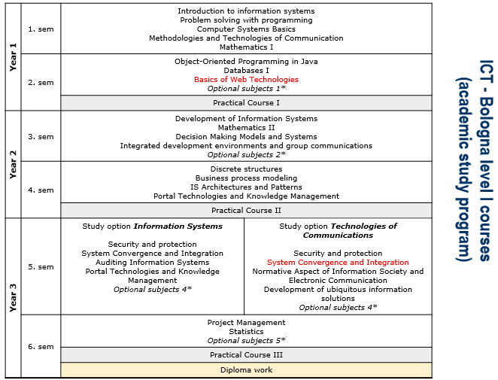
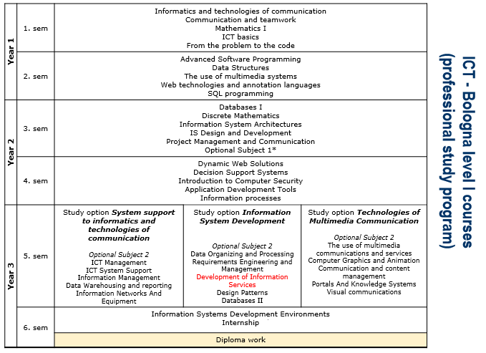
Studying XML in UM FERI
Academic study program (1st year):
Basics of web technologies
Basics of XML and its connection to HTML
Academic study program (3rd year):
System convergence and integration
Specifics of XML and its use in Java web services and Java applications
Professional study program (3rd year)
Development of information services
Specifics of XML and its use in C# web services ands C# applications

Slide 3
The learning process in XML and WS development oriented subjects
HTML and related
XML and related technologies
XML manipulation in Java/C#
WS and integration (SOAP, REST)

Slide 4
Web Service Development in 1st year academic study program (Basics of Web Technologies)
HTML and related
XML and related technologies
XML manipulation in Java/C#
WS and integration (SOAP, REST)
Web Service Development in 3d year academic study program as well as professional study program (System Convergence and Integration, Development of Information Services)
HTML and related
XML and related technologies
XML manipulation in Java/C#
WS and integration (SOAP, REST)

Slide 5
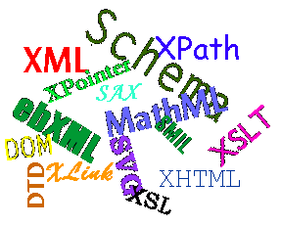
XML 10-year motivation
A standard, independent universal data format (structure and description of data)
Vastly used in Slovenia (libraries, banks, government) – workshop organization
Growing interest in smaller private companies

Slide 6
Problems of companies
Small companies need a small-budget project for transforming their contents into XML and taking advantage of all supporting technologies
Various non-standard formats are required to be transformed into a suitable format:
Suitable for printing (PDF)
Presented in different devices
The transformation process is usually time consuming, error prone, takes a lot of effort and includes involvement of several actors
The usual transformation process does not enable content management

Slide 7
Problems in our studies
PROBLEM 1: simple test data in labs (due to the short time in one semester)
PROBLEM 2: study approach
Project oriented work gives poorer results in grades
Week-to-week oriented work gives poorer results in extended understanding of the problem area and self-initiative research

Slide 8
Using XML in studies
(step 1) Understanding XML as a way of storing/presenting/transmitting data
e-business, web services
(step 2) Understanding XML as a way of recognizing the document‘s contents
Involvement of several interested smaller companies with (extremely) mixed XML structures
Publishing house Forum
PRIZMA Foundation for improving employment

Slide 9
The contents of the XML document
Structured XML contents | Mixed XML contents
<narocilo> <datumNarocila>21.1.2011 </datumNarocila> <datumOdposiljanja>25.1.2011 </datumOdposiljanja> <placnik> <ime>Boštjan Šumak</ime> <ulica>Smetanova ul. 17 </ulica> <mesto>Maribor</mesto> <postnaSt>2000</postnaSt> <posta>Maribor</posta> </placnik> <telefon>022355108</telefon> <faks>022355134</faks> </narocilo> | <sporocilo pomembnost=‘velika' datum=‘3.23.2005'> <posiljatelj>Boštjan Šumak </posiljatelj> <prejemnik>Luka Pavlič </prejemnik> <naslov>Končna verzija </naslov> <telo><emph>Nemudoma</emph> se morava pogovoriti o zadnji verziji. Ali me kontaktiraj po <email> mailto:bostjan.sumak@uni- mb.si</email> ali pokliči na <telefon>022355108</telefon> </telo> </sporocilo>

Slide 10
Solutions? We know the process!
XSLT PDF
XSLT HTML
…
PDF
Content management (XML technology)
HTML
.docx
Content recognition
Data/ XML content
Transformations (XSLT)
Program components
ePub
…
Upgrade possibilities:
Involvement of semantic technologies and tools/techniques for smart management
External document generating
Itd.

Slide 11
Phase 1: Transformation (DocX → XML)
Template
The contents of the XML document from DocX needs to be optimized.
Template tree
Final tree
Input tree
Final document
Input
document
Optimized
XML
XML
DocX
The transformation process

Slide 12
Transforming .odt and .docx into XML
.doc – the older binary format
.docx – newer, XML based format
.odt – different background
XML format, within .odt or .docx includes a lot of code/elements, not connected to the contents
Libraries DOCX:
Opencode library JODConverter
Apache POI, NPOI (enables reading .doc as well as .docx) - does not enable advanced reading of the documents
DocX, XML SDK (only for .docx format)
Libraries ODT:
Apache ODF Toolkit, ODFDOM, Apache Jena

Slide 13
Phase 2: Building XML schema
An XML schema needs to be developed, providing structure for XML document building (structure and contents), XML data base and components for development on different phases of publishing
The XML schema needs to be developed in a general manner, enabling flexibility at adding new structure/elements without influencing existing solutions/contents

Slide 14
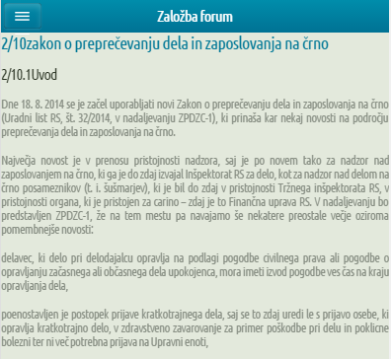
Phase 3: Building external formats
When an optimized XML is created, it can be used for:
Transformation to various formats
Intelligent understanding of the contents
Presentation (HTML, PDF, ePub)
Source (DOCX)
XSLT
FO engine
XSL-FO
Word
XML
XSLT
CSS
XSLT
HTML
XSLT

Slide 15
XML to PDF transformation dilemma: using XSL-FO or generating it
Defining contents using FO processor
an XSL-FO transformation is defined
open source
Apache FOP – from most open source solutions it offers most functionality (although not all)
iText
payable
XEP, AntenaHouse Formatter, …
The market is full with other (payable) libraries, however they provide less functionality
Generating contents using iText
XML contents is read and a PDF is generated
A less flexible solution, if we want to make PDF changes in the future
If the output is required to change, the source code must be altered
iText is also payable if used for commercial solutions

Slide 16
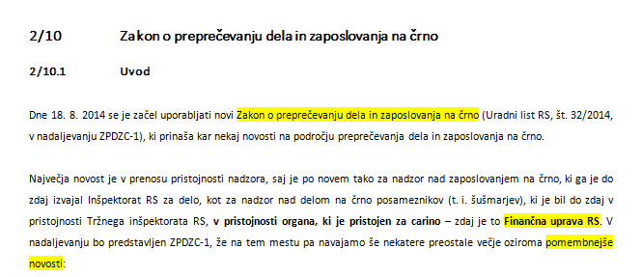
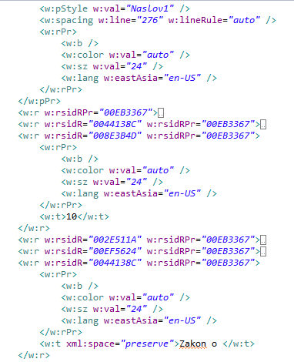
Preparing the standard file
DOCX contents is XML, however suitable for formatting in MS Word
It does not contain XML elements, which would semantically define the contents

Slide 17
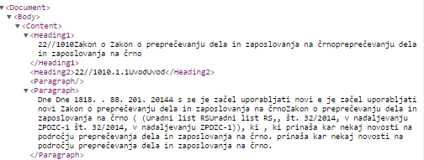
Transforming DOCX XML into a standard XML document

Slide 18
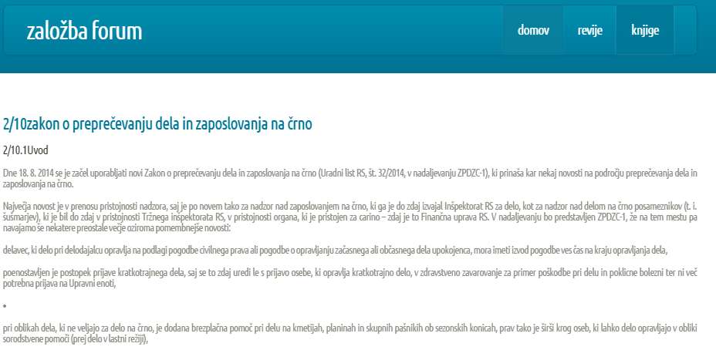
A transformation into a responsive HTML

Slide 19
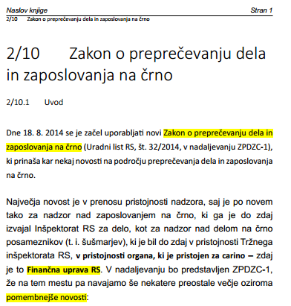
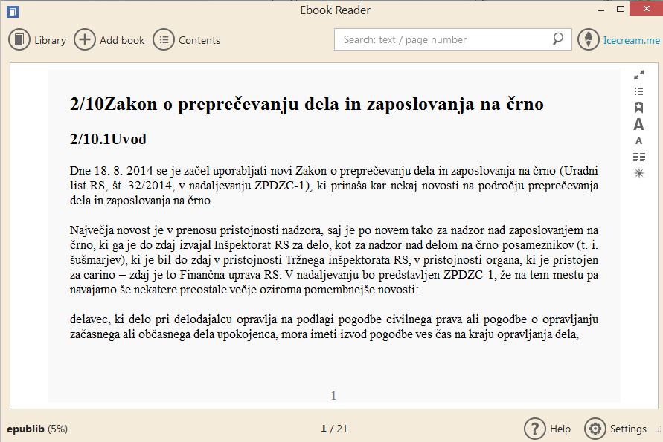
PDF, ePub transformation

Slide 20
Students (quick) results
2013/2014
2014/2015

Slide 21
Conclusion
Define lab themes suitable for students
Project oriented
Week-to-week report
Using real-life companies with real life problems.
Extending the use of XML technologies for various data format transformations
Application of this project on possible public calls for proposals

Slide 22
Thank you
Questions?

